Slide 1
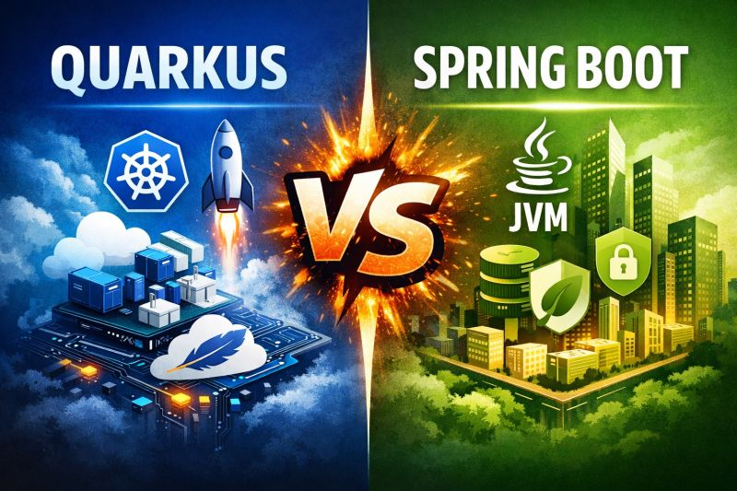
Quarkus vs Spring Boot

Slide 2
🚀 What You’ll Learn
Spring Boot Overview
Quarkus Overview
Key Differences (Spring Boot vs Quarkus)
Live Coding Demo
When to Use What

Slide 3
What is Spring Boot?
🔥 Most Popular Java Framework
🏢 Widely Used in Top Companies
⚡ Rapid Development (Less Configuration)
🧩 Auto Configuration Built-in
🌍 Huge Community Support
🚀 Easy to Learn & Get Started
💡 Code less. Build faster. Scale better.

Slide 4
🚀 What is Quarkus?
🔥 Kubernetes-Native Java Framework
⚡ Super Fast Startup & Low Memory Usage
☁️ Built for Cloud & Microservices
🧩 Reactive & Non-Blocking by Design
🐳 Perfect for Containers & Serverless
🚀 Developer Joy (Live Reload + Fast Dev Mode)
💡 Run Java faster. Scale smarter. Go cloud-native.

Slide 5
Simple Analogy
Spring Boot = Truck (powerful but heavy)
Quarkus = Bike (fast & lightweight)

Slide 6
Key Differences
Feature | Quarkus 🚀 | Spring Boot 🌱
What is it? | Modern Java framework | Popular Java framework
Startup Time | Very fast ⚡ | Normal 🐢
Memory Usage | Less | More
Easy to Learn | Medium | Very Easy
Community | Small | Very Big
Best For | Cloud & microservices | All types of apps
Industry Use | Growing | Very High

Slide 7
🚀 When to Use Spring Boot
Use Spring Boot when stability, ecosystem, and flexibility matter most.
1. Enterprise / Large Applications
Complex business logic
Long-running services
Banking, insurance, enterprise SaaS
👉 Why?
Mature ecosystem (Spring Security, Spring Data, etc.)
Huge community support
Easier hiring & onboarding
2. Microservices (Traditional style)
REST APIs
CRUD-heavy services
Service-to-service communication
👉 Works great with:
Spring Cloud
Netflix OSS stack
3. When Team Experience Matters
Your team already knows Spring
Faster development due to familiarity
4. Rich Feature Requirements
Security (OAuth2, JWT)
Transactions
Batch processing
👉 Spring gives everything out-of-the-box.
⚠️ Not Ideal When:
You need ultra-fast startup
Memory is limited (e.g., serverless)

Slide 8
⚡ When to Use Quarkus
Use Quarkus when performance and cloud-native efficiency matter.
✅ Best for:
1. Cloud-Native & Kubernetes Apps
Containers
Auto-scaling microservices
👉 Why?
Designed for Kubernetes
Fast startup (milliseconds)
2. Serverless / Functions
AWS Lambda / GCP Functions
👉 Benefit:
Low cold start time
Less memory usage
3. High Performance APIs
Reactive systems
Event-driven architecture
👉 Built with:
Vert.x (non-blocking)
Reactive programming model
4. DevOps-Heavy Environments
CI/CD pipelines
Docker-first workflows
👉 Features:
Live reload
Small container images
⚠️ Not Ideal When:
Your team is new to it
You need heavy Spring ecosystem features

Slide 9
When to Use Quarkus
☁️ Building Cloud-Native Applications
Perfect for Kubernetes, Docker & modern deployments
⚡ Need Fast Startup & Low Memory
Ideal for microservices and high-scale systems
🧩 Reactive & High-Concurrency Systems
Best for handling thousands of requests efficiently
🐳 Container & Serverless Environments
Optimized for lightweight and fast-running apps
🚀 Faster Development Cycles
Live reload + dev mode boosts productivity
🌍 Microservices Architecture
Great for distributed, scalable systems
💡 Use Quarkus when performance, scalability, and cloud-native design matter most.

Slide 10
🚫 When NOT to Use Quarkus?
🏢 Traditional Monolithic Applications
Spring Boot is often simpler & more mature here
📚 Need Huge Ecosystem Support
Spring has a much larger ecosystem & integrations
👨‍💻 Team is Already Deep into Spring
Switching may reduce productivity initially
🧩 Simple CRUD Applications
Quarkus might feel like over-optimization
⏳ No Need for Fast Startup / Low Memory
Quarkus strengths won’t add much value
🔌 Heavy Dependency on Spring Features
Rewriting or adapting may take extra effort
💡 Choose Quarkus for performance & cloud-native needs — not for every project.

Slide 11
Thank you….

